Slide 1
Capstone Project -1
Play Store App Review Analysis
By: Sumit kumar

Slide 2
Points for discussion
Defining the problem statement
Introduction to Play store Platform
Exploring the database
Features selection
Top ‘Genres’ and their analysis
Free apps VS Paid apps
Impact of ‘Rating’
Users Subjectivity and Sentiment
Conclusion

Slide 3
Defining the problem statement
“The Play Store apps data has enormous potential to drive app-making businesses to success. Actionable insights can be drawn for developers to work on and capture the Android market.
Each app (row) has values for category, rating, size, and more. Another dataset contains
customer reviews of the android apps.
Explore and analyze the data to discover key factors responsible for app engagement and success.”
From the problem statement given, we should analyze the given database and should come up with the key factors that increased the number of users, long term usage and etc.,
The objective of this project is to deliver insights to understand customer demands
better and thus help developers to popularize the product.

Slide 4
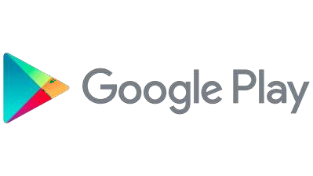
Introduction to Play store Platform
Play store is an Android Market serves as the official app store for certified devices
running on the Android Operating system.
Developed and Operated by Google, launched on 6th March, 2012.
Also called as Google Play store.
Approximately 3.48 million apps are in Play store.
Each apps are having separate product page with user review and rating system.
All the apps are separated into different categories based on the purpose.

Slide 5
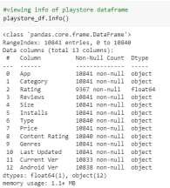
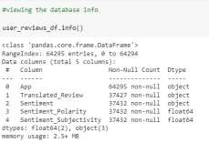
Exploring the database
We have been provided with two databases
Play store app database
Shape of this database is (10841, 13).
Out of this thirteen columns we have numeric
columns like Rating, Reviews, Size, Installs.
User reviews database
Shape of this database is (64295, 5).
Here there are only two numeric values found,
Sentiment Subjectivity, Sentiment Polarity.

Slide 6
Features selection
The columns are also known as features, one or more different features are grouped together for different
analyses to form a data frame.
top_genres_df: It contains the rows of top ‘Genres’ based on the app counts.
genres_free_apps_installs_df: It holds the rows of top ‘Genres’ and corresponding total free app installs count.
genres_paid_apps_installs_df: It holds the rows of top ‘Genres’ and corresponding total paid app installs count.
genres_ratings_df: It takes the rows of top ‘Genres’ and their corresponding mean Rating.
top_50_genres_df: This data frame contains the rows of features top Genres, Free app installs count, Paid app
installs count and Rating.
category_type_installs_df: It contains the rows of Category wise free and paid apps installs count.
price_df: This holds the rows of paid apps’ non null price values.
category_price_mean_df: This holds the rows of Category wise mean price of paid apps.
rating_df: This holds the rows of mean price for all the apps.
category_mean_rating_df: It contains the rows of Category wise mean rating of all the apps.
content_rating_df: It holds the rows of different aged people wise ratings count.
non_null_user_reviews_df: It holds the different users’ non null Sentiment type, Sentiment Subjectivity
distribution and Sentiment Polarity.
sentiment_subjectivity_df: It holds the different users’ sentiment subjectivity distribution.

Slide 7
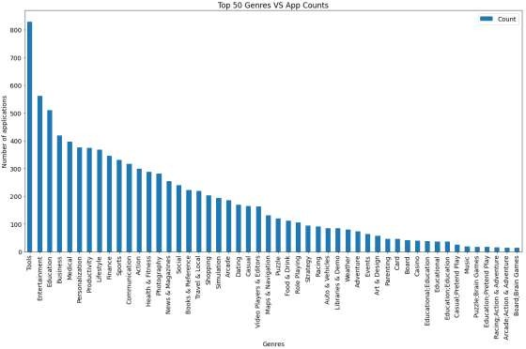
Top ‘Genres’ and their analysis
The analyze is done between the top 50 Genres which was having more number of downloads
As we saw here, the Play store having more number of applications in the genres like Tools, Entertainment, Education and etc.,
The developers are mostly focusing on these, genres because of the people daily basis requirements.
Genres likes Educational, Parenting, Music are having comparatively less amount of apps count.

Slide 8
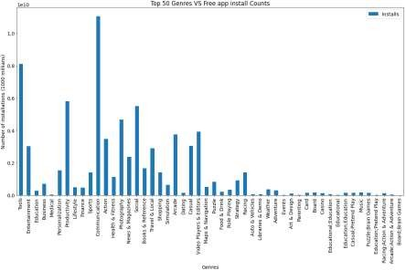
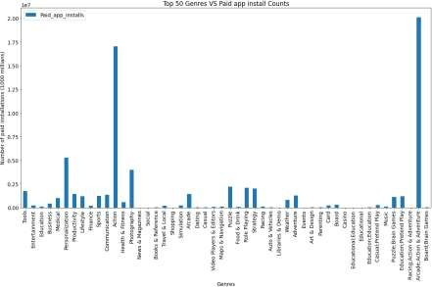
Free apps VS Paid apps Installs (Top genres based)
When comparing the both plots, people are showing more interest on free apps like communication, Tools.
When it’s coming commercial people are preferring the apps like Games, Photography, Personalization.
Again the Educational, Parenting and Music are
the genres in the least.
People are preferring less on Educational, Event,
Art & Design.

Slide 9
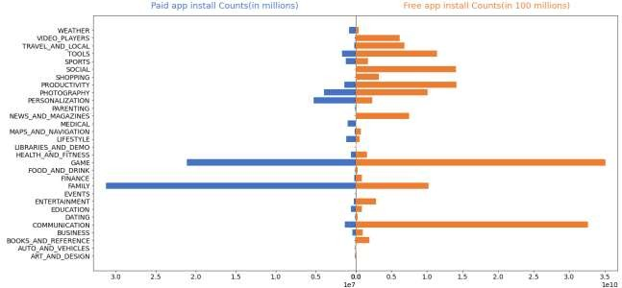
Free apps VS Paid apps Installs (Category based)
Each categories are showing huge difference between their downloads comparison.
People are spending more money in Family and Game.
The overall category wise difference can be seen in Game.
Communication also having some considerable
amount of installed number in Free apps.

Slide 10
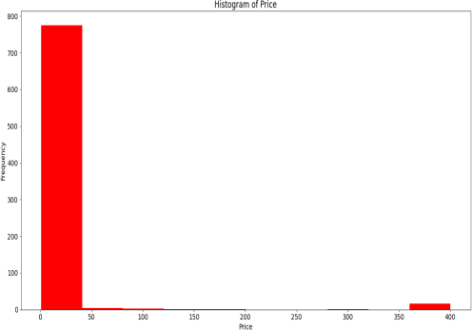
Price distribution
The distribution of Price plotted as we see here.
Most of the paid apps are in between the price range of 0 to 50 USD.
Few apps are in the price range of 350 to
400 USD.
Very few of the apps pricing between 75 to
200 USD.

Slide 11
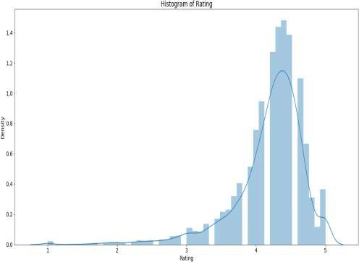
Impact of ‘Rating’
In general Rating is the main scale factor, measures that how much people are satisfied with the product.
Here, most of the people rated the apps between the range of 4 to 5, which are can be considered as good.
Moderate rating is lies between 2.5 to 4.
And below average or poor apps are in the
range of 0 to 2.5 which are less in count.

Slide 12
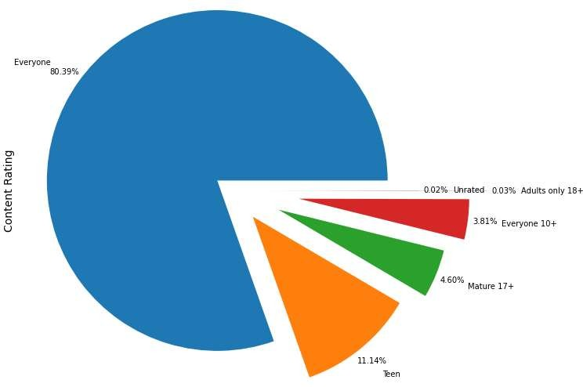
Impact of ‘Rating’
The content rating shows the results for
general contents as high.
The content rating type ‘Everyone’ has the most percentage value of 80.39%.
‘Teen’ contents are second in the order with the percentage of 11.14%.
Adults only and Unrated contents are least in this plot, 0.03% and 0.02% respectively.
So it can be concluded that most of the contents are generic.

Slide 13
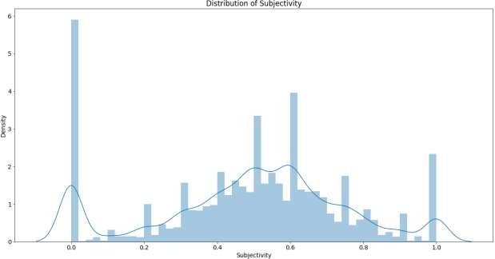
Users Subjectivity and Sentiment
Subjectivity are lies mostly between 0.5 and 0.65.
It shows that the average content and apps reviews subjectivity are mostly relevant.
Subjectivity of 100% has slightly occurs frequently.
The nearly 0 subjectivity has a considerable amount of frequency.

Slide 14
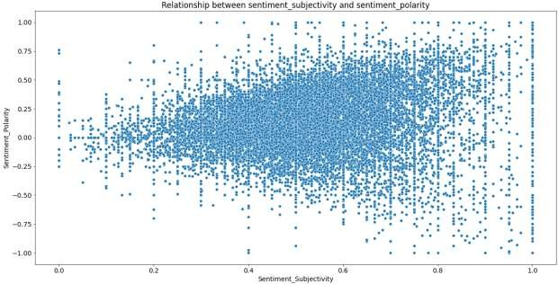
Users Subjectivity and Sentiment (Continued)
From the above scatter plot it can be concluded that sentiment subjectivity is not always proportional to sentiment polarity but in maximum number of case, shows a proportional behavior, when variance is too high or low

Slide 15
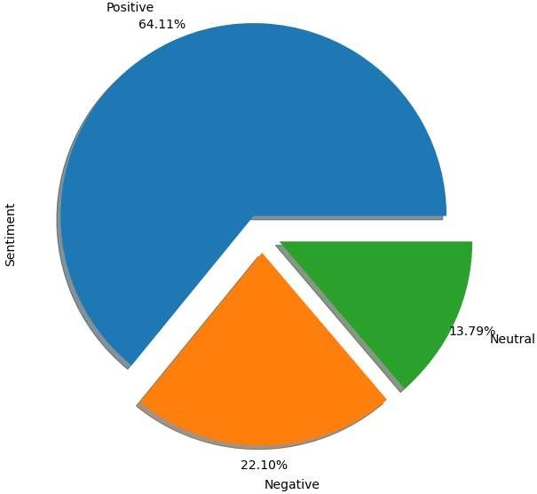
Users Subjectivity and Sentiment (Continued)
The sentiment plot shows the results for positive
reviews as high.
Sentiment type ‘Positive’ has the most percentage value of 64.11%.
‘Negative’ reviews are with the percentage of 22.10%.
‘Neutral’ percentage has 13.79%.

Slide 16
Conclusion
After analyzing the dataset we have got answers to some of the serious & interesting facts
which any of the android users would love to know.
Top Genres on Google Play store.
Top Categories on Google Play store.
Which Category of Content is downloaded more?
Which category of apps has the most number of installs?
What are the Top 10 installed apps in different categories?
Distribution of the ratings of the apps
Variation between Free and Paid apps
Which are the top expensive Apps?
Distribution of the Price of the apps
Which are the apps that have made the highest-earning?
Which are the Apps with the highest number of reviews?

Slide 17
Thank You

